Slide 1
?
WHAT IS

Slide 2
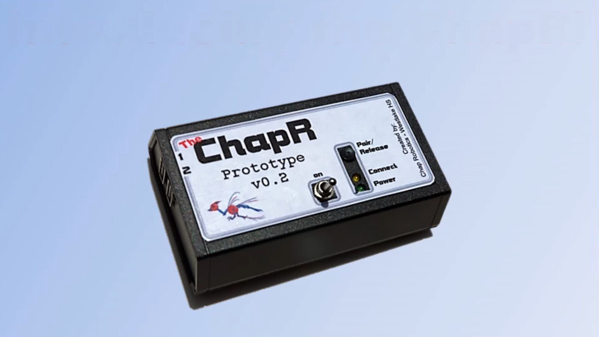

Slide 3
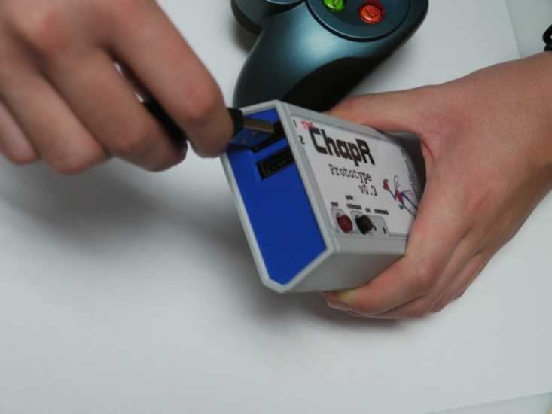
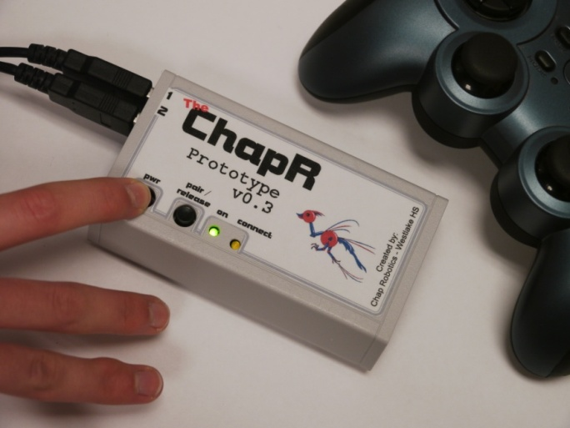
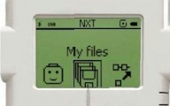
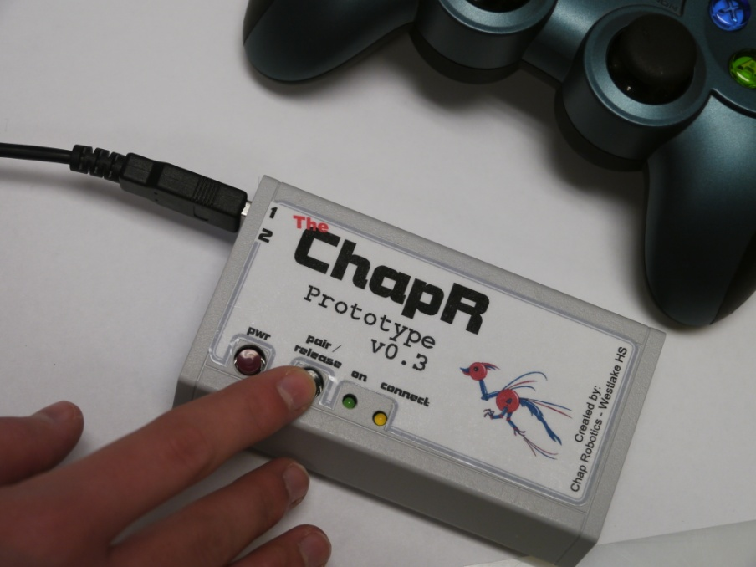
Basic Use
1.
Plug in joysticks
2.
Hold power button to turn on
3.
Select program
4.
Hit the action button if needed

Slide 4
The Journey
The Steps of Our “Start-Up”

Slide 5
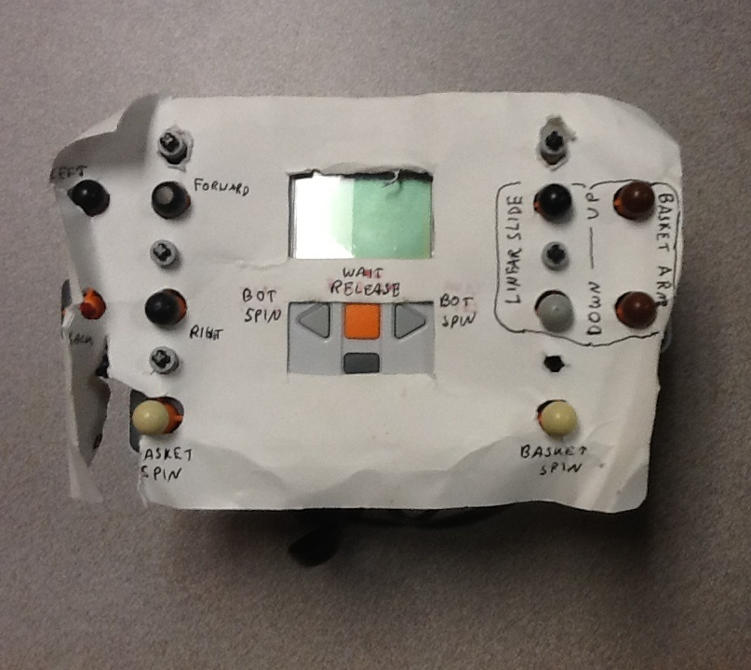
v0.0 – The Inspiration

Slide 6
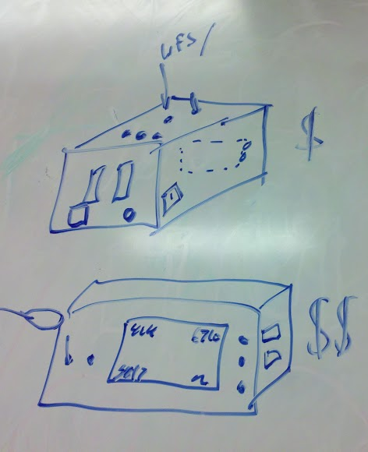
Product Development
*FTC 2 Joystick Control
- Bluetooth
- no PC
- easy to use
- battery (rechargeable? monitor LED?)
- existing brick and software
- full-field range
- low lag
- waitForStart() release
- teleOp remote start
- changeable battery
- field upgrade-able (cable to computer or file on USB)
- companion website with FAQs and tutorials

Slide 7
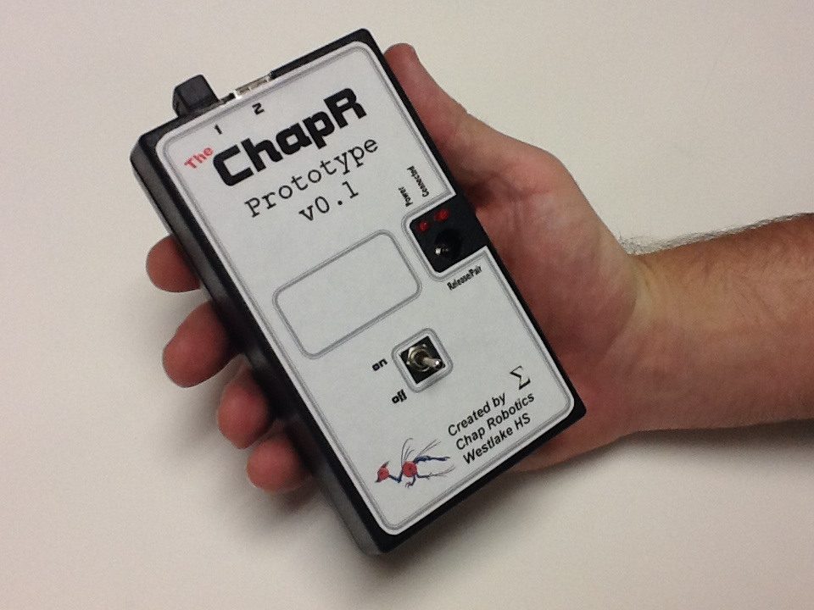
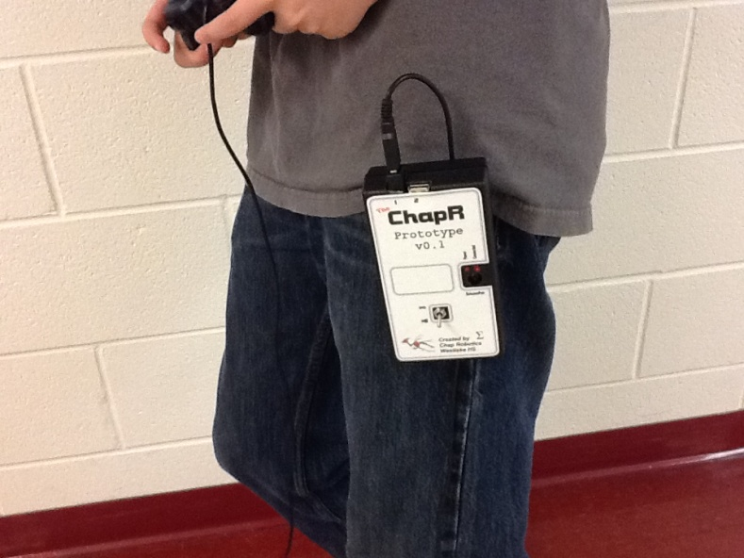
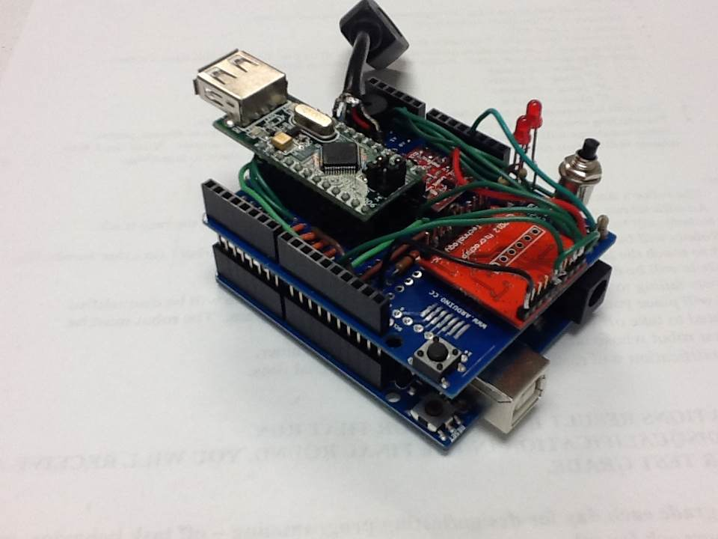
v0.1 – Arduino Uno and Shield

Slide 8
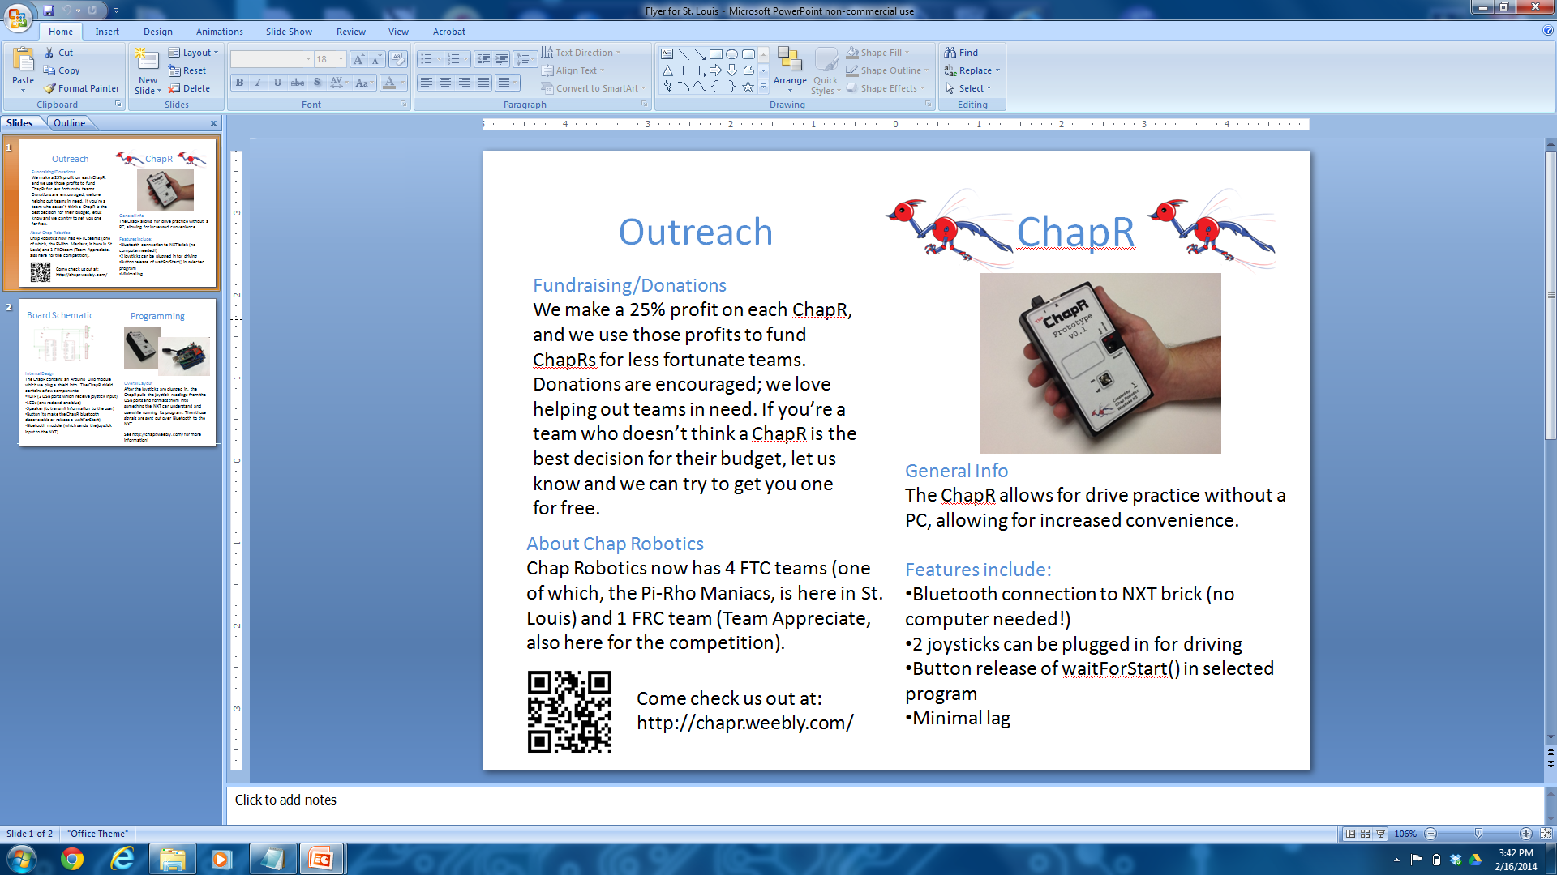
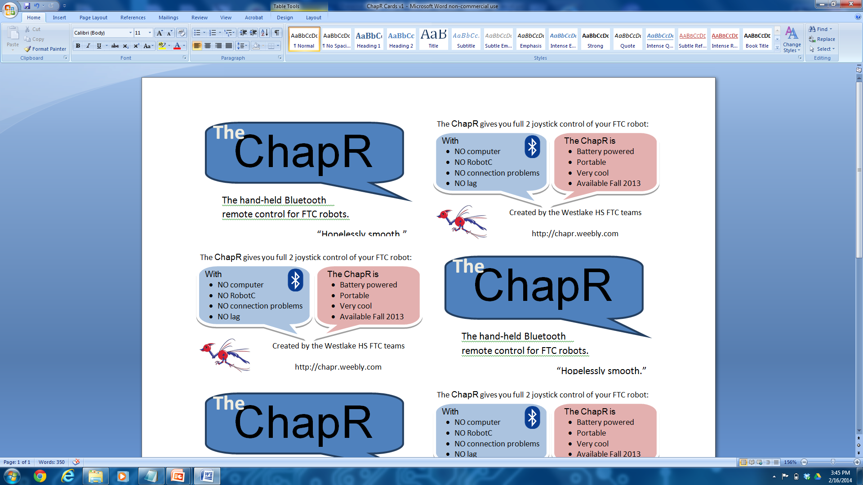
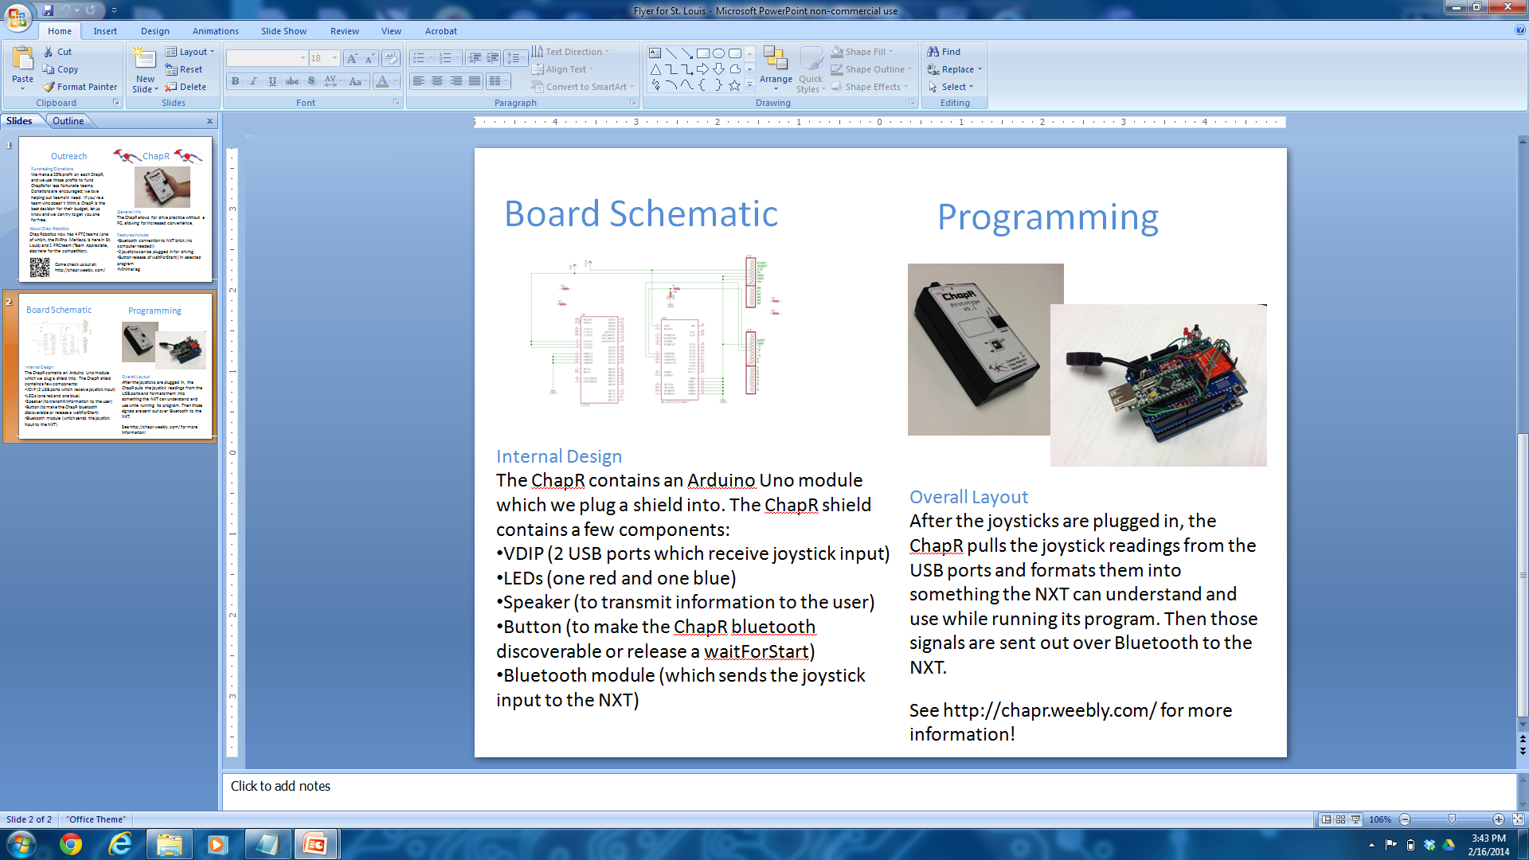
Market Analysis

Slide 9
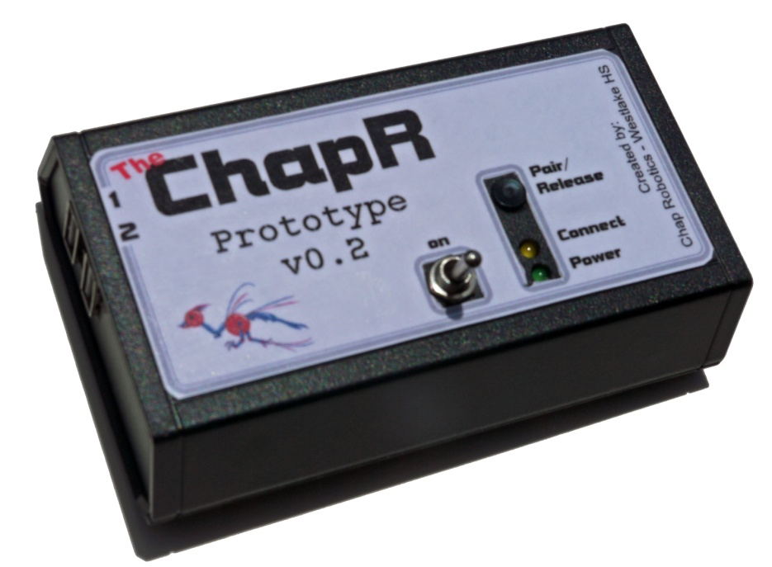
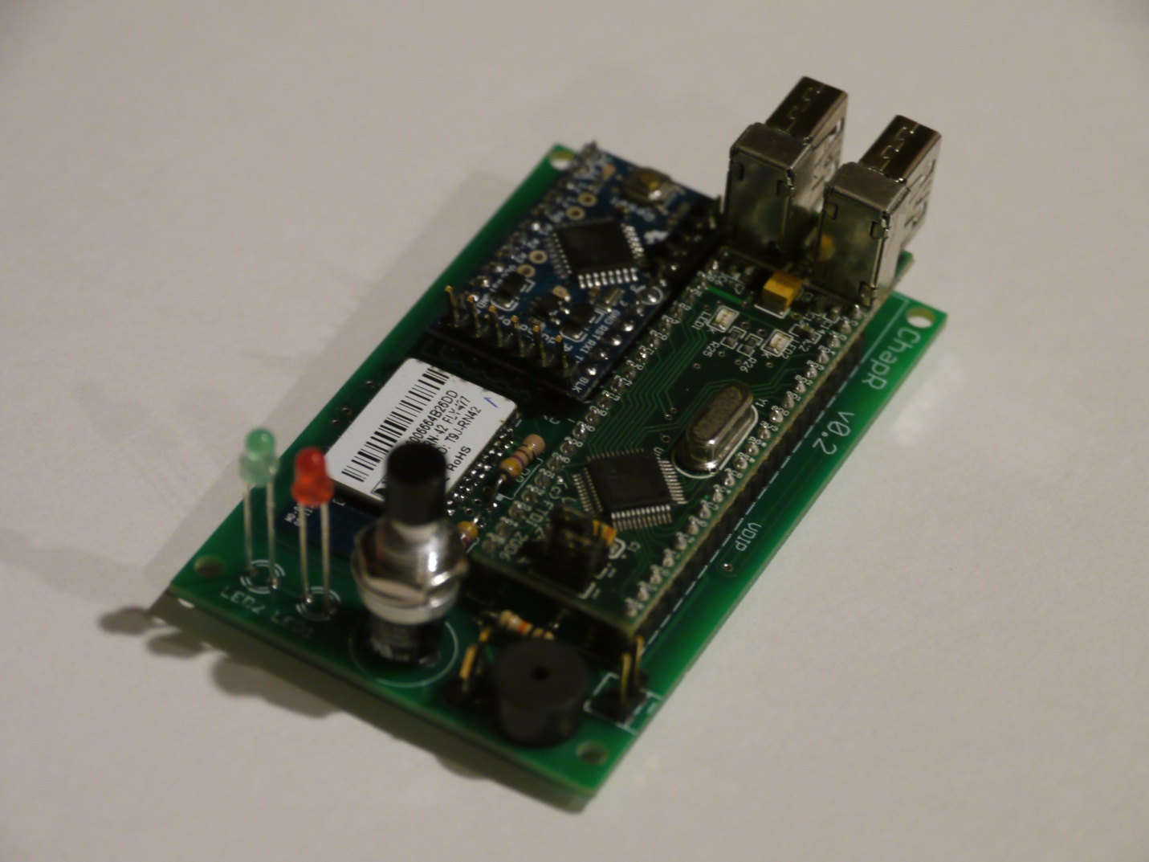
v0.2 – Custom PCB

Slide 10
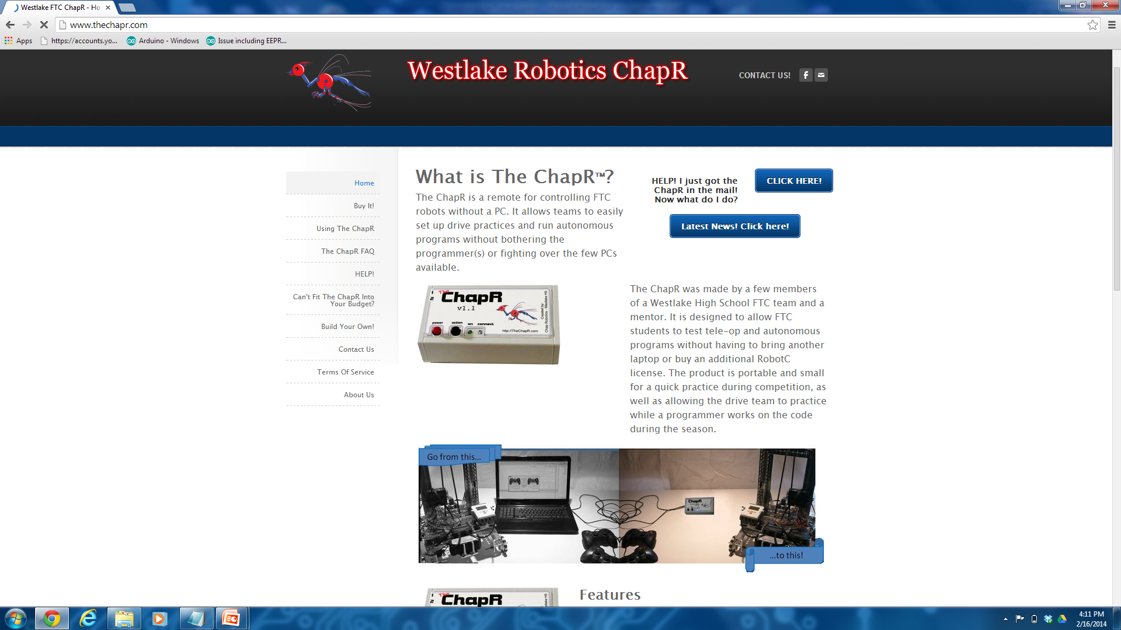
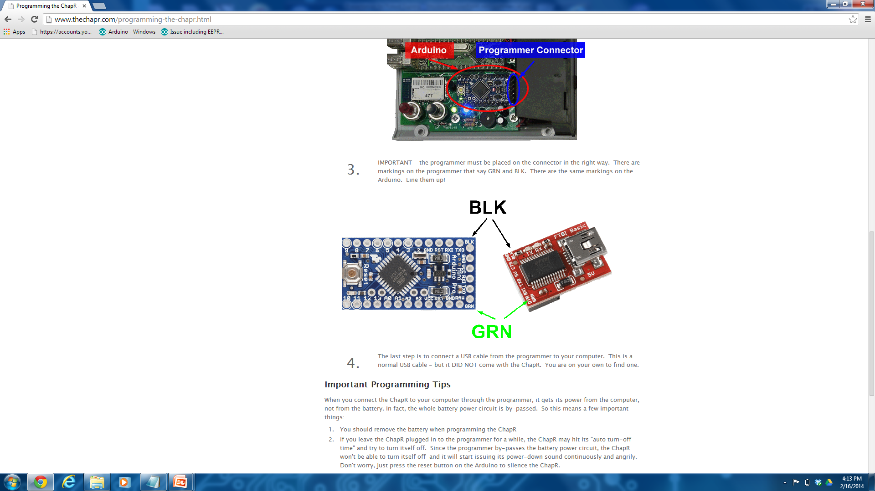
Website Progress

Slide 11
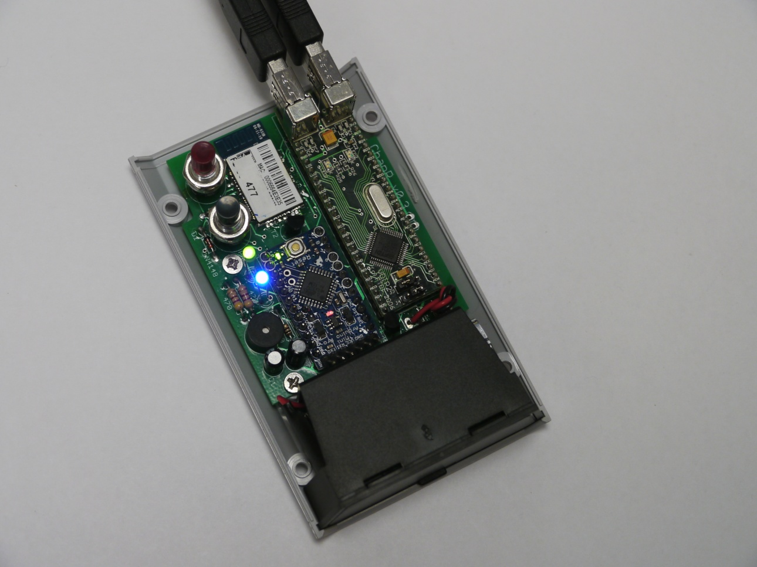
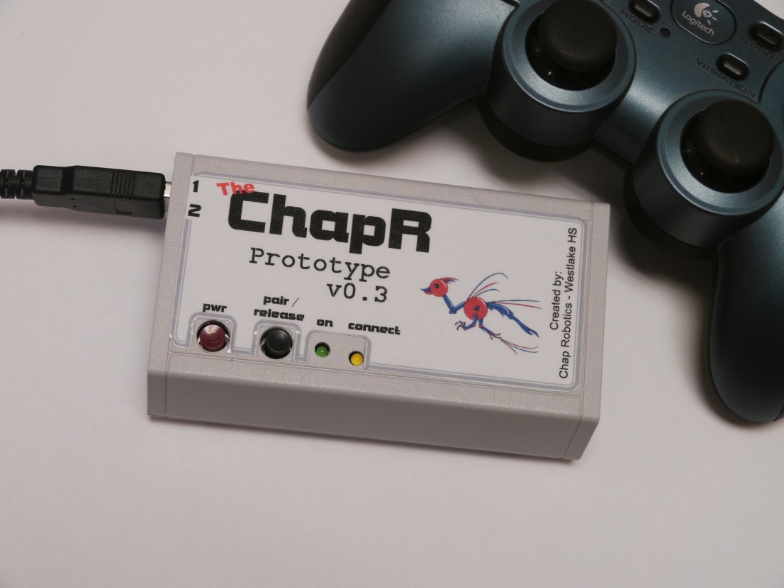
v0.3 – Updated Case and Board

Slide 12
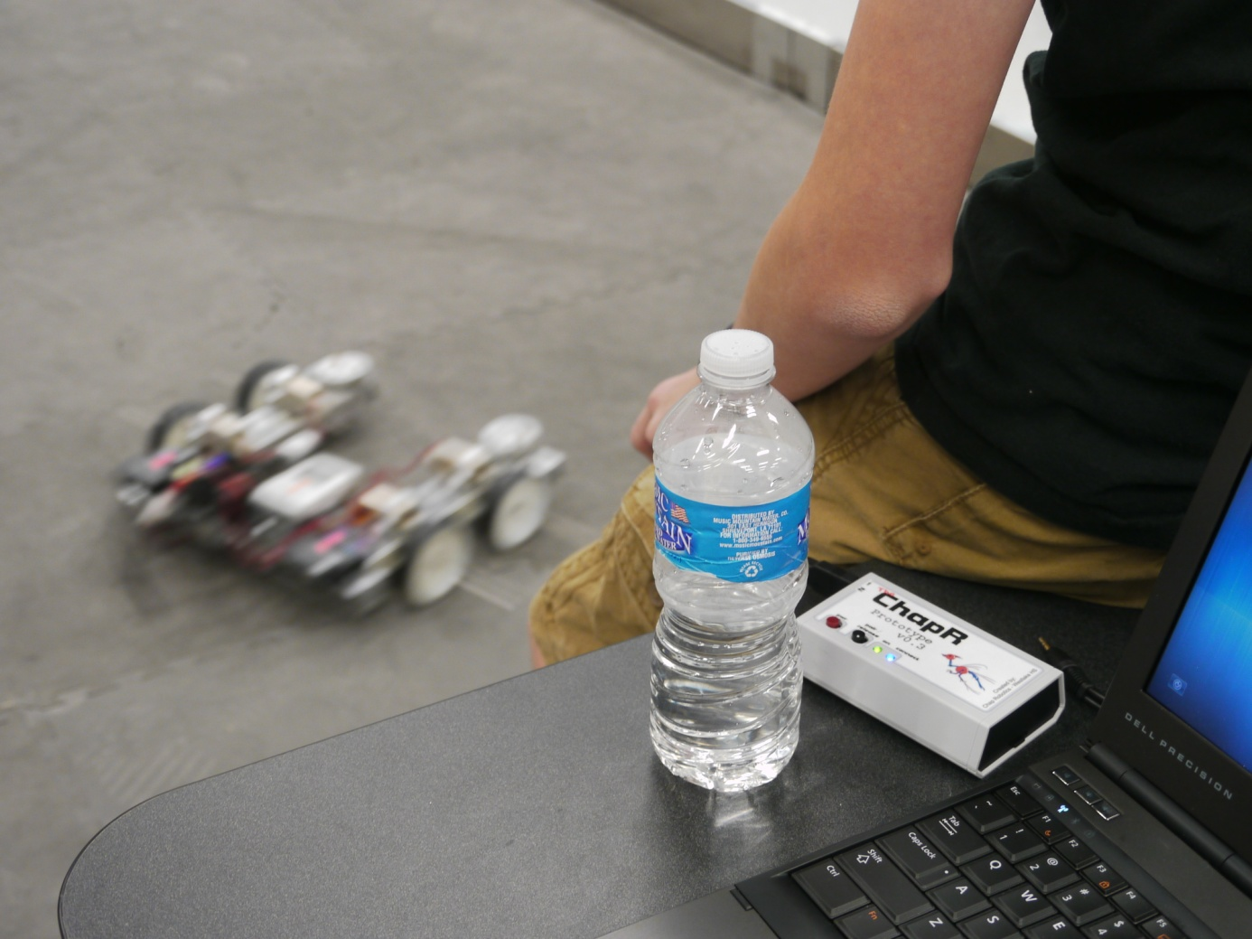
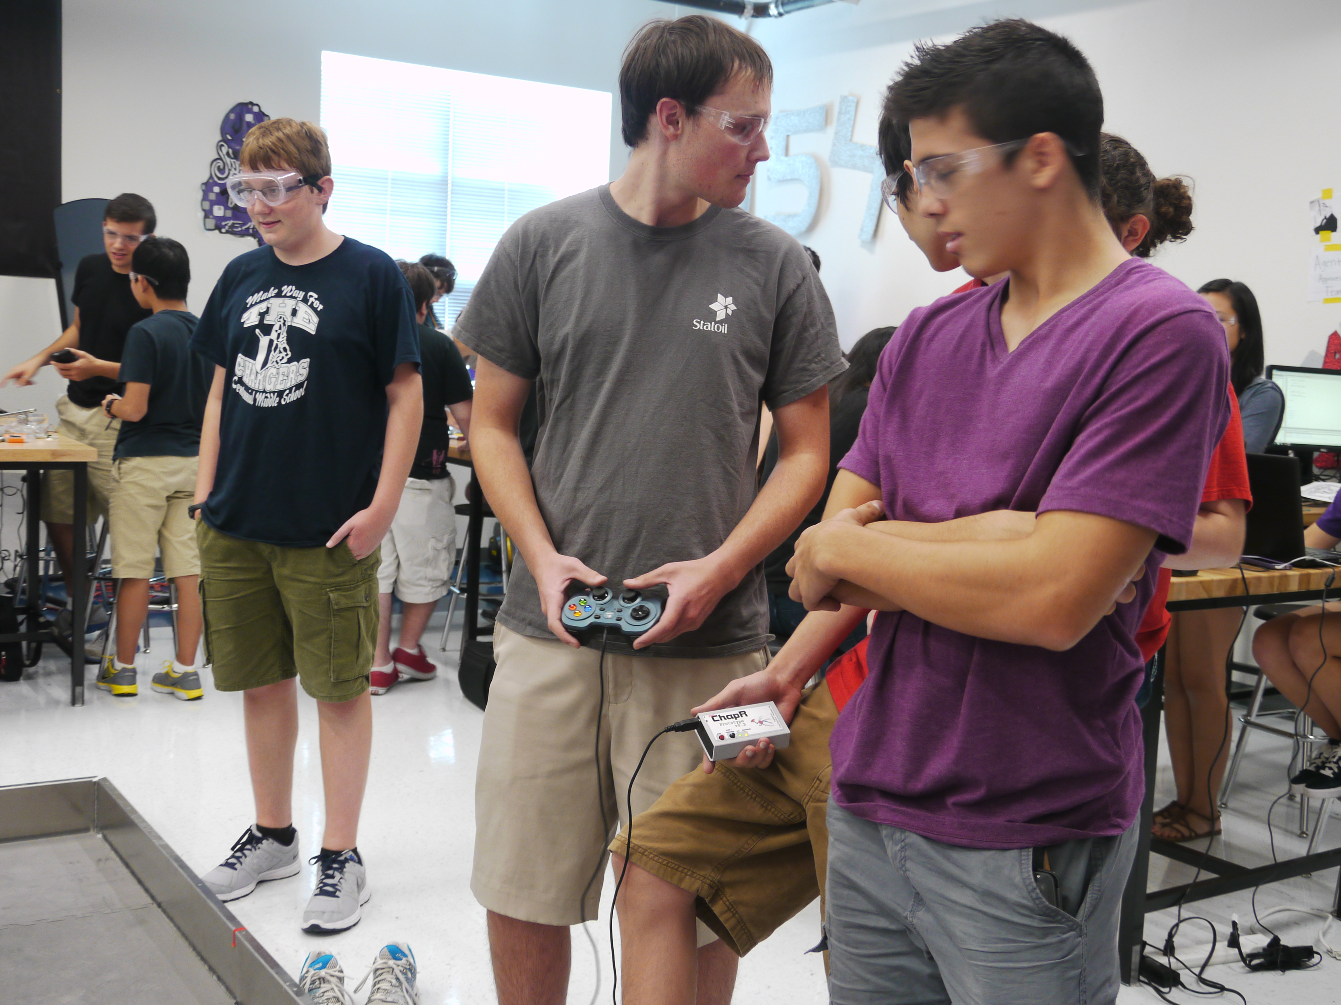
Beta Testing

Slide 13
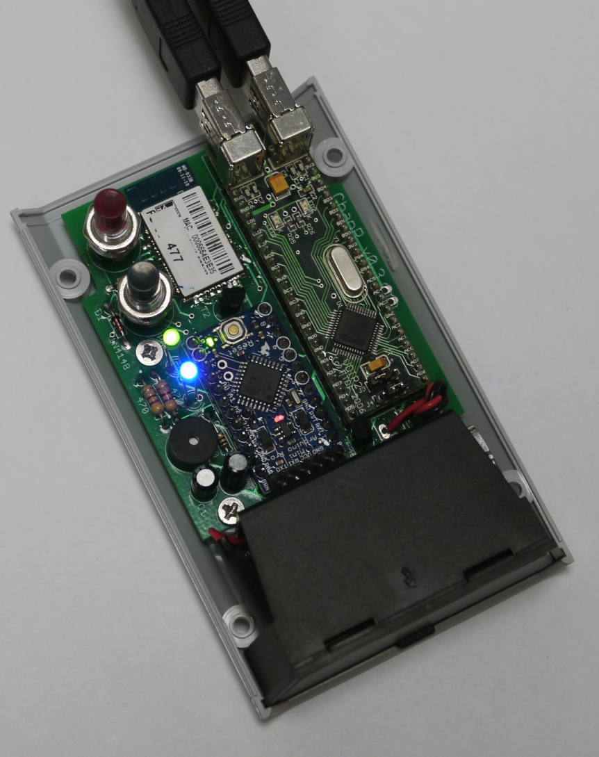
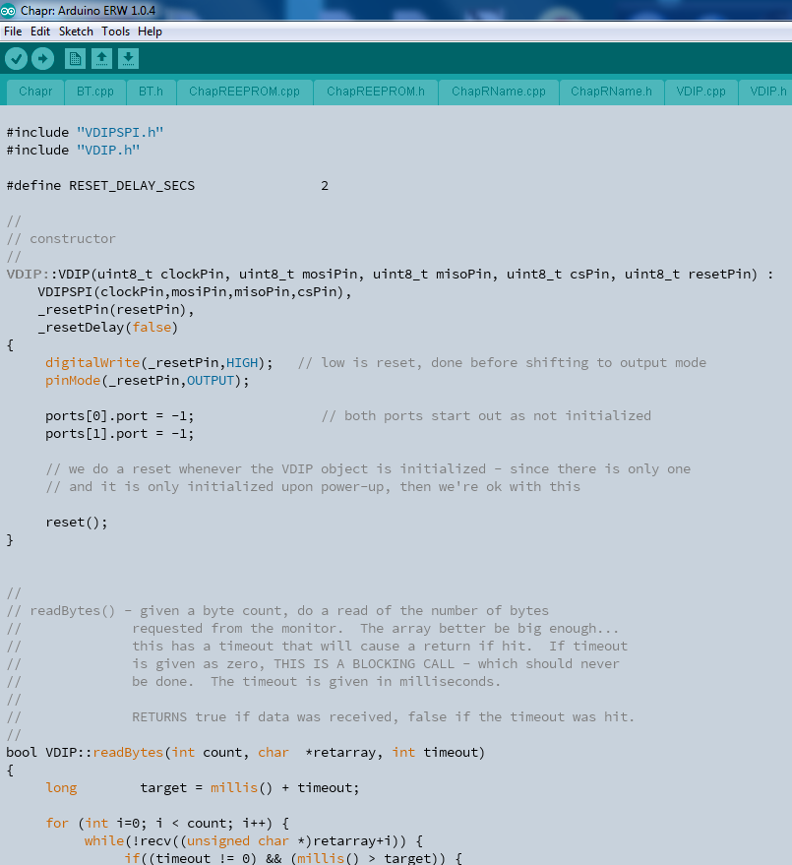
v1.0 – Release version

Slide 14
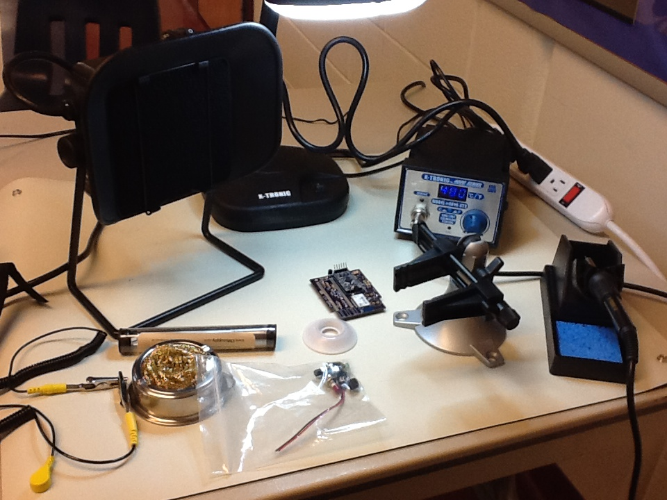
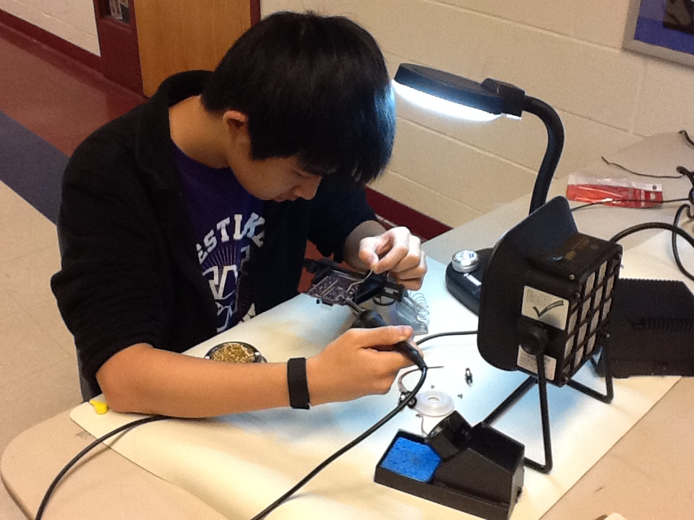
Manufacturing

